Slide 1
Software Fundamentals Series
Databases and SQL
IEEE Computer Society Ryerson Chapter
October 5th, 2020

Slide 2
Data
Data is everywhere
Every application you use contains data related to various kinds of information
E.g.
Facebook stores data such as users, user friends, user posts, user likes etc.
Banks stores data such as users, user money, user account etc.
How is this data stored and associated with each other?
Databases

Slide 3
Databases
Program structure that allows data be stored in a specific format
Includes a Database Management System (DBMS) that provides the functionality to add to, modify, and query the data quickly
query: instructions for retrieving data from a database

Slide 4
Types of Databases
Relational
Non-Relational (noSQL)
Object Oriented
Distributed
Real Time
And many more!

Slide 5
Relational Databases
Most popular database model
Popular relational DBMSs include: MySQL, Microsoft SQL Server, Oracle Database, PostgreSQL, Db2
Table structure
Uses multiple tables to relate data entries

Slide 6
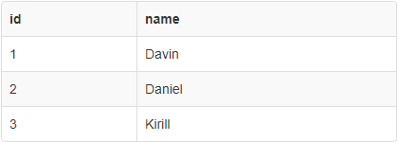
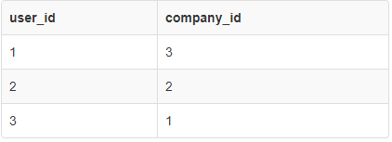
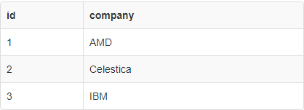
Relational Databases
Notes:
Having multiple tables that relate to each other can be useful in many cases. You can have it so that one table refers to another table’s id value to reduce the amount of times you might need to rewrite data, and instead simply change it in one table and refer to that thing by its id for other tables.

Slide 7
SQL
Structured Query Language
Allows you to access databases and perform queries, create tables, edit data, etc.
ANSI standard but there are many versions of SQL for each DBMS
In order to satisfy ANSI standard, all versions support certain core commands
Notes:
Databases are very efficient, more efficient than dictionaries/arrays. The dictionaries/arrays are saved in the ram of the system as opposed to the hard drive on a server for example.

Slide 8
Why Learn SQL?
All companies have data and that is stored in databases
Most companies use relational databases
Applies to many fields such as:
Web Development
Cloud Computing
Big Data Analytics
Machine Learning
Learning SQL makes you more EMPLOYABLE!
Notes:
Mention how running tests and simulations for various conditions can all be stored in an SQL database which can be accessed and displayed on a website for ease of access of results. You can also use a website as a GUI to input and delete data from the database. #MyAMDExperience

Slide 9
MySQL
One of the most popular DBMS
Open Source
Multi-platform
Used in many websites including Google, Facebook, Youtube

Slide 10
SQL Tutorial
Notes:
https://www.w3schools.com/sql/trysql.asp?filename=trysql_select_all

Slide 11
MySQL General Syntax
Case insensitive
However, it is good practise to write reserved words in all UPPERCASE
i.e.) SELECT * FROM table;
Whitespace insensitive
Semicolon terminated

Slide 12

Basic Database Structure
Database
1
*
Data is inserted
DATA TABLES
Data is queried

Slide 13

CREATE DATABASE
The database is where TABLES are created and organized
The CREATE DATABASE command is used to created a new SQL database
NOTE: For the workshop, we will use the w3schools web GUI to act as our database
Thus, the CREATE DATABASE statement is not required in this case
Notes:
Typically you just work with pre-established databases such as mysql, SQLite, Django, mongoDB, OracleDB
We will be using the w3schools tutorial which is very useful if you want to go through this or other programming languages such as perl, java, python, etc.
https://www.w3schools.com/sql/trysql.asp?filename=trysql_select_all

Slide 14
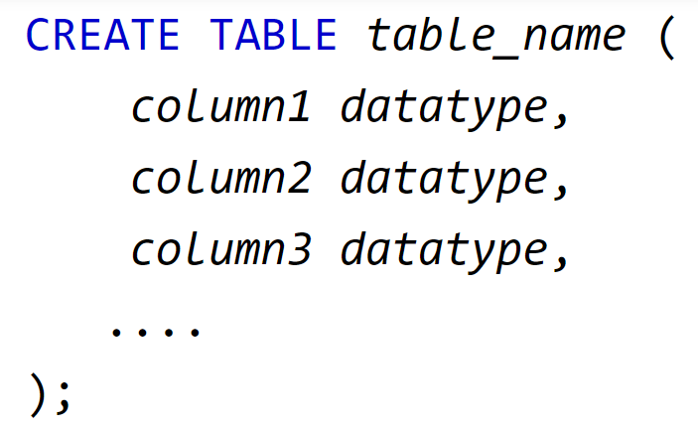
CREATE TABLE
The CREATE TABLE statement creates a table within the database

Slide 15
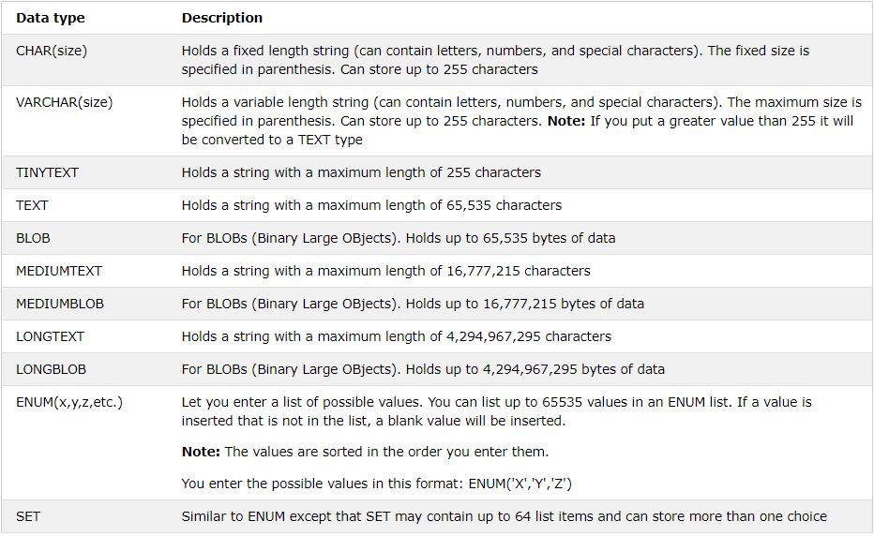
Datatypes (Text)

Slide 16
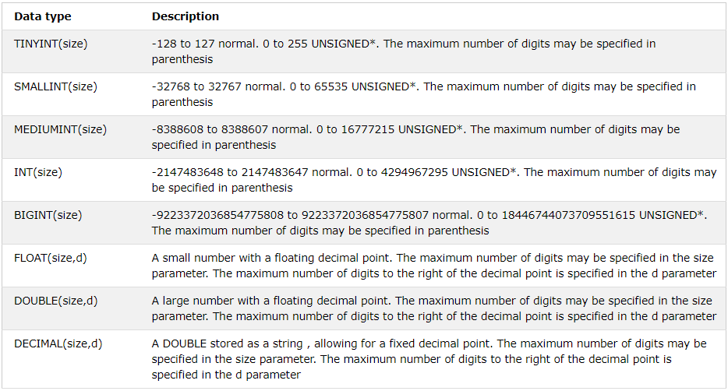
Datatypes (Numeric)

Slide 17
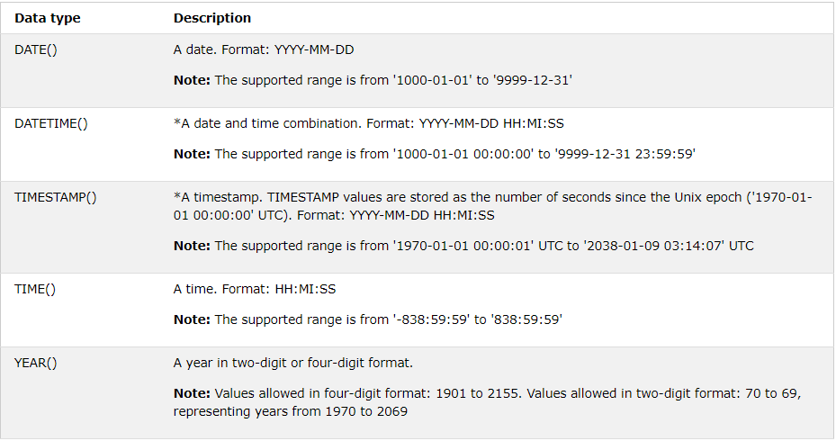
Datatypes (Date)

Slide 18
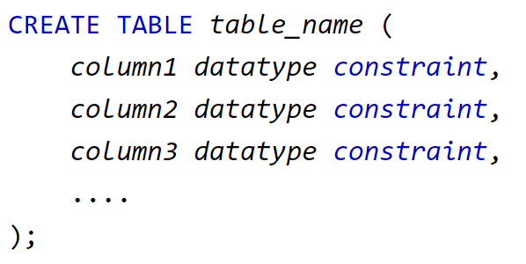
CREATE Constraints
The CREATE statement may also be used with creates to implement special rules for the data in the table

Slide 19
Common Constraints
Common constraints include
NOT NULL: Ensures that a column cannot have a NULL value
UNIQUE: Ensures that all values in a column are different
PRIMARY KEY: A combination of a NOT NULL and UNIQUE. Uniquely identifies each row in a table
FOREIGN KEY: Uniquely identifies a row/record in another table
CHECK: Ensures that all values in a column satisfies a specific condition
DEFAULT: Sets a default value for a column when no value is specified
INDEX: Used to create and retrieve data from the database very quickly

Slide 20
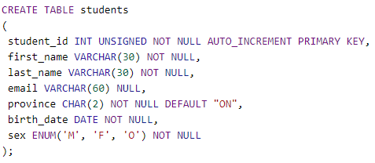
CREATE TABLE Example
Notes:
ENUM is from MySQL syntax and will not work.
CREATE TABLE students
(
student_id INT UNSIGNED NOT NULL PRIMARY KEY,
first_name VARCHAR(30) NOT NULL,
last_name VARCHAR(30) NOT NULL,
email VARCHAR(60) NULL,
province CHAR(2) NOT NULL DEFAULT "ON",
birth_date DATE NOT NULL,
sex CHAR(1) NOT NULL
);

Slide 21

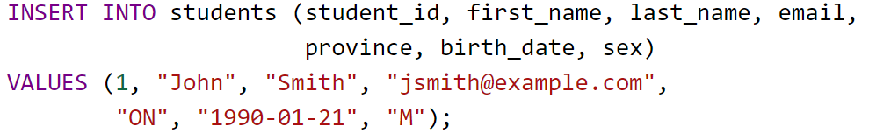
SQL INSERT Statement
The INSERT statement is used to insert new data into a TABLE
The order of the column names are stated first, followed by the data value that correspond to each column
i.e.)
Notes:
INSERT INTO students (student_id, first_name, last_name, email,
province, birth_date, sex)
VALUES (1, "John", "Smith", "jsmith@example.com",
"ON", "1990-01-21", "M"), (2, "Jane", "Doe", "jdoe@example.com",
"ON", "1990-02-22", "F");

Slide 22
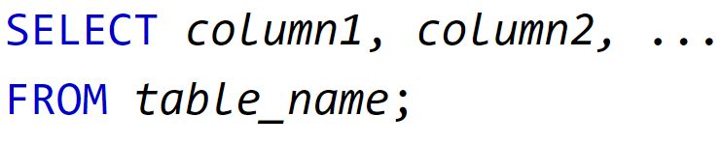

SELECT statement
The SELECT statement is used to select and display data from a database
Select all columns, use the * operator:
* = ‘ALL’
Notes:
SELECT * FROM students;

Slide 23
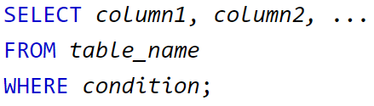
WHERE statement
Used to filter records
Extracts records that fulfill specific condition
Note: conditions are specified on columns
Notes:
SELECT student_id FROM students where student_id<2;

Slide 24
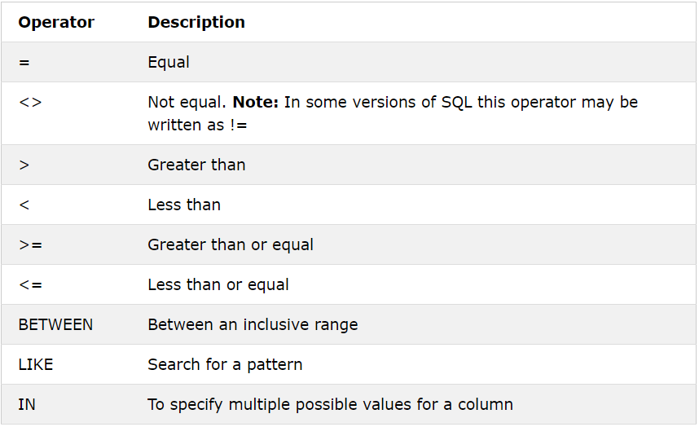
WHERE conditions

Slide 25
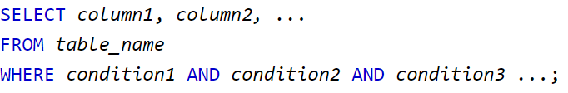
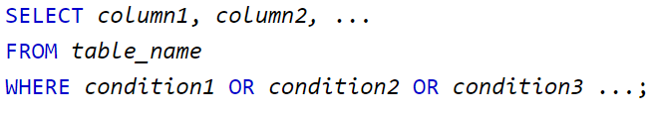
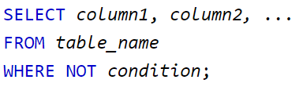
WHERE - AND, OR, NOT
A combination of the logical operators (AND, OR, NOT) can be used in the WHERE statement

Slide 26
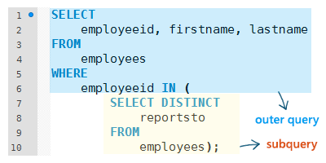
Nested SELECT statements
SELECT statements can be nested within a WHERE condition
You can refer to other tables in the nested SELECT
Notes:
You can have your select statements to be nested, where you search of a condition within a condition.
This can be useful when using data from one table to refer to another table.
SELECT * FROM [Customers]
WHERE CustomerID IN (SELECT CustomerID
FROM Orders WHERE OrderDate >= "1997-02-02");
Example: Getting a list of all the customers who visited our shop after a case of covid-19

Slide 27
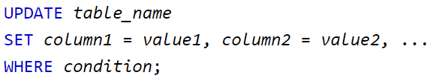
UPDATE statement
Used to modify existing records in the table
Notes:
UPDATE students SET province="BC" WHERE student_id=1;

Slide 28

DELETE statement
Used to delete existing records from the database
Notes:
DELETE FROM students where student_id=2;

Slide 29

ALTER TABLE
The ALTER statement allows users to ADD, DELETE (DROP), MODIFY columns
ADD column Statement
f
i.e.)
Notes:
ALTER TABLE students ADD enrolled boolean;

Slide 30


ALTER TABLE (con’t)
The DROP statement allows you to remove a column from the TABLE
DROP column statement
~
i.e.)
MODIFY column statement
~
i.e.)
Notes:
ALTER TABLE students DROP COLUMN enrolled;
ALTER TABLE students MODIFY COLUMN sex int unsigned;

Slide 31

DROP TABLE
The DROP TABLE statement removes the TABLE from the DATABASE you are currently in
The DROP statement
~
i.e.)
Notes:
DROP TABLE students;
This is probably not a good idea to do especially if your at work, basically just deletes everything.

Slide 32
Python implementation with SQLite
-SQLite is a Database API that is integrated as a standard python library
-This allows you to use and create a database locally
-If you guys don’t have python installed you can use repl.it as a python emulator
Notes:
https://repl.it/
First Step: Change theme to dark mode

Slide 33
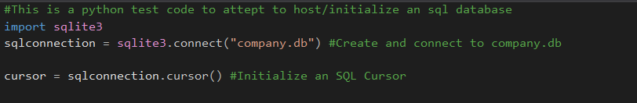
Python implementation with SQLite
-First step is to initialize the database and initialize a cursor
Notes:
The connection initialization opens up the database file mentioned, in this case company.db, an set a connection variable to be used down the line.
You must also initialize a cursor, this cursor is used to either submit commands to SQLite and to fetch results from there.

Slide 34
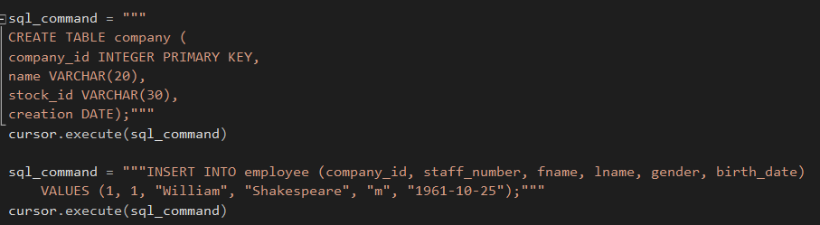
Python implementation with SQLite
-You can create a variable to feed into cursor.execute()
Notes:
Here we are using the cursor to execute commands to create a table and to insert an entry into.

Slide 35
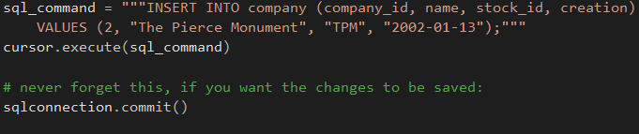
Python implementation with SQLite
-After having adding things you need to remember to save!!!
Notes:
Here we are commit our changes to the database, similar terminology to git

Slide 36
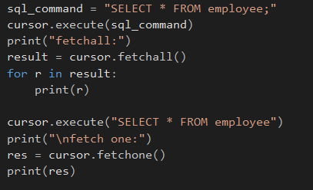
Python implementation with SQLite
-You can query the database with the use of cursor.fetchall() or cursor.fetchone()
Notes:
Here we are feeding the cursor.fetchall() into result which is then iterated through.
cursor.fetchone() only gets you the first result from the table

Slide 37
Closing Remarks
These slides are meant to provide you with the fundamental tools necessary for SQL databases. There is much, much more you can do with SQL databases than what is provided during this workshop. Additional resources have been provided in the same repository.
Thank you to those who supported us by attending our workshop. Feel free to provide us with feedback and what you might be interested in learning in future workshops.
- IEEE Computer Society Ryerson Chapter Team

